Slide 1

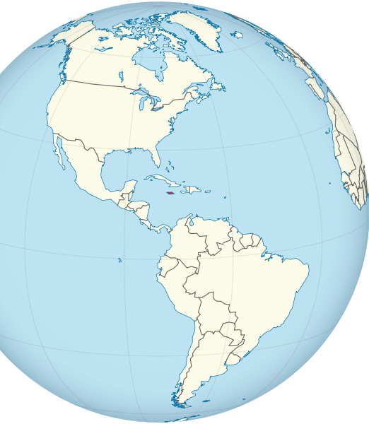
Living
Christ-like
in an
un-Christ-like World
This Photo by Unknown Author is licensed under CC BY-SA

Slide 2
How to live as salt and light
Matthew 5:13-16

Slide 3
salt and light
Salt is Distinctive
  Followers of Jesus are to be distinctive

Slide 4
James 1:27
“Pure and undefiled religion before God is this: to visit orphans and widows in their trouble, and to keep oneself unspotted from the world.”

Slide 5
Romans 12:2
“And do not be conformed to this world,
but be transformed
by the renewing of your mind, that you may prove what is that good and acceptable and perfect will of God.”

Slide 6
1 John 2:15-16
“Do not love the world or the things in the world. If anyone loves the world, the love of the Father is not in him. For all that is in the world- the desire of the body, the desire of material goods, and honorable position – is not of the Father but is of the world.”

Slide 7
salt and light
Salt Preserves- it cleans
    it slows the process of decay

Slide 8
1 Peter 1: 22-25
“Since you have purified your souls in obeying the truth through the Holy Spirit in sincere love of the brethren, love one another fervently with a pure heart, having been born again, not of corruptible seed but incorruptible, through the word of God which lives and abides forever, because ‘All flesh is as grass, it withers, and its flower falls away, But the word of the Lord endures forever.’ Now this is the word by which the gospel was preached to you.”

Slide 9
salt and light
Salt Flavors
    makes food more palatable

Slide 10
Colossians 4:6
“Let your speech always be with grace, seasoned with salt, that you may know how you ought to answer each one.”

Slide 11
Luke 14:34-35
“Salt is good; but if the salt has lost its flavor, how shall it be seasoned?
It is neither fit for the land nor the dunghill, but men throw it out. He who has ears to hear, let him hear!”

Slide 12
salt and light
Salt is Precious
    valued commodity

Slide 13
1 Peter 3:3-4
“Do not let your adornment be only outward- arranging the hair, wearing gold, or putting on fine apparel – rather let it be the hidden person of the heart, with the incorruptible beauty of a gentle and quiet spirit, which is very precious in the sight of God.”

Slide 14
salt and light
The church is not a salt factory where we stockpile salt!

Slide 15
salt and light
“You are the light of the world”

Slide 16
John 8:12
“Then Jesus spoke to them again, saying,
‘I am the light of the world. He who follows Me shall not walk in darkness, but have the light of life.”

Slide 17
1 John 1:5
“This is the message which we have heard from Him and declare to you, that God is light and in Him is no darkness at all.”

Slide 18
John 9:5
Jesus said
“As long as I am in the world, I am the light of the world.”

Slide 19
Ephesians 5:8-11
“For you were once darkness, but now you are light in the Lord. Walk as children of light finding out what is acceptable to the Lord. And have no fellowship with the unfruitful works of darkness, but rather expose them.”

Slide 20
John 12:35-36
“he who walks in darkness does not know where he is going. While you have the light, believe in the light, that you may become sons of light.”

Slide 21
John 12:46
“I have come as a light into the world, that whoever believes in Me should not abide in darkness.”

Slide 22
salt and light
Jesus declared that we would be
        SALT
        and
        LIGHT

Slide 23
Living
Christ-like
in an
un-Christ-like World
This Photo by Unknown Author is licensed under CC BY-SA

